Slide 1
Decision Trees
Anshu Pandey

Slide 2


Agenda
Decision Tree Introduction
Classification Tree
Regression Tree
Advantages and Disadvantages
Implementation of Decision Trees
Random Forest
Implementation of Random Forest

Slide 3
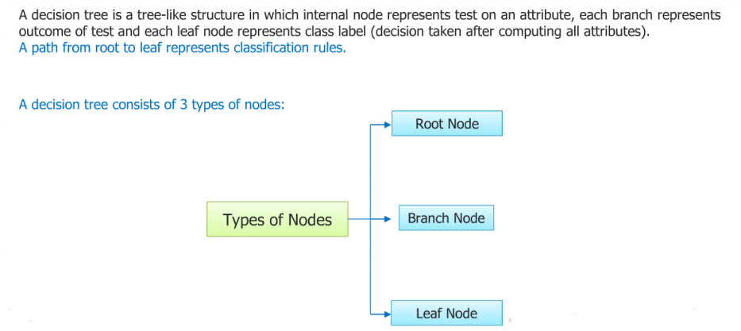
Decision Trees
A decision tree is a tree like graphical representation of possible solutions to a decision based on certain conditions.

Slide 4
Decision Trees
A decision tree has three main components : Root Node : The top most node is called Root Node. It implies the best predictor (independent variable).
Decision / Internal Node : The nodes in which predictors (independent variables) are tested and each branch represents an outcome of the test
Leaf / Terminal Node : It holds a class label (category) - Yes or No (Final Classification Outcome).

Slide 5
How Decision Tree works:
Pick the variable that gives the best split (based on lowest Gini Index)
Partition the data based on the value of this variable
Repeat step 1 and step 2. Splitting stops when CART detects no further gain can be made, or some pre-set stopping rules are met. (Alternatively, the data are split as much as possible and then the tree is later pruned.

Slide 6
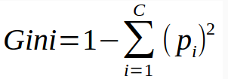
Gini Index
Gini Index measures impurity in node. It varies between 0 and (1-1/n) where n is the number of categories in a dependent variable.

Slide 7
Gini index
Important Points :
Zero.gini index implies perfect classification.
(1 - (1/ No. of classes) implies worst classification
We want a variable split having a low Gini Index.

Slide 8
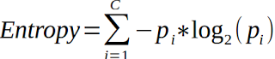
Entropy / Information Gain
Entropy: Amount of Uncertainty in decision making
Smaller value of Entropy signifies a good classification.
Information Gain : = Entropy(parent) - Weighted Sum of Entropy(Children)

Slide 9
Steps to calculate entropy for a split:
Calculate entropy of parent node
Calculate entropy of each individual node of split and calculate weighted average of all sub-nodes available in split.

Slide 10
Chi-Square
It is an algorithm to find out the statistical significance between the differences between sub-nodes and parent node. We measure it by sum of squares of standardized differences between observed and expected frequencies of target variable.
Chi-square = ((Actual – Expected)^2 / Expected)^1/2
It generates tree called CHAID (Chi-square Automatic Interaction Detector)

Slide 11
Steps to Calculate Chi-square for a split:
Calculate Chi-square for individual node by calculating the deviation for Success and Failure both
Calculated Chi-square of Split using Sum of all Chi-square of success and Failure of each node of the split

Slide 12
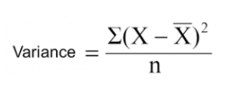
Regression Tree
The impurity of a node is measured by the Least-Squared Deviation (LSD), which is simply the within variance for the node.
Above X-bar is mean of the values, X is actual and n is number of values.

Slide 13
Steps to calculate Variance:
Calculate variance for each node.
Calculate variance for each split as weighted average of each node variance.

Slide 14
Which is better - Entropy or Gini
Both splitting criterias are approximately similar and produces similar result in 95% of the cases. Gini is comparatively faster than Entropy as it does not require calculation of log.

Slide 15
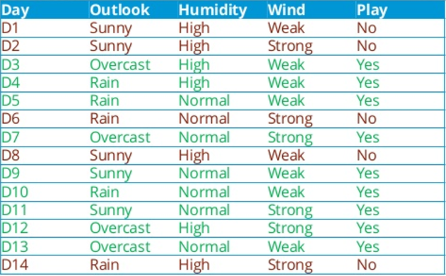
How Decision Tree works?
Weather information of last 14 days –
Whether match was played on those days or not.
Now using decision tree we have to predict that for given conditions –
Outlook – Rainy
Humidity – High
Wind – Weak
Match - ?

Slide 16
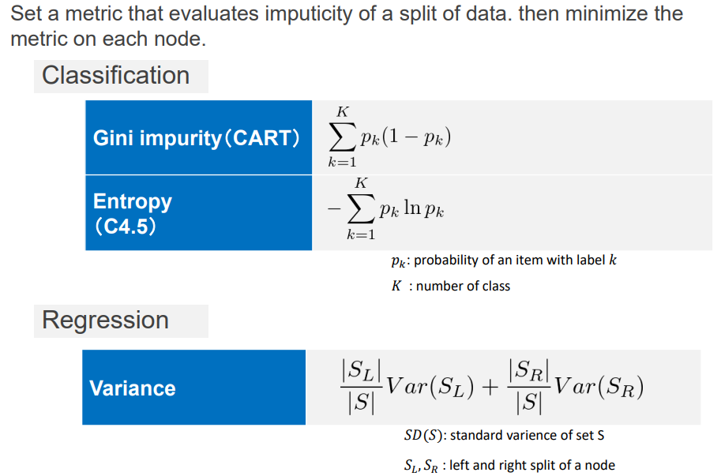
Decision Trees

Slide 17
Pruning : Correct Overfitting
It is a technique to correct overfitting problem. It reduces the size of decision trees by removing sections of the tree that provide little power to classify instances. It is used to remove anomalies in the training data due to noise or outliers.

Slide 18
Business Scenario and Advantage
Among patients profile, who will respond better with such treatment
So by putting rest of them into another kind of treatment
Among customers, Find profile of those who will attrite vs. those will stay with the business
So by targeting such customer you can reduce attrition?
Among applicants, Find which are the applicants, who can be fraud (such as cases of account take over)
So by working on few selected applications you can avoid lots of account take over fraud cases

Slide 19
Business Scenario and Advantage
Among prospect of home loan pool, Find who are the prospects customer, who will switch over their home loan
So by not working on few prospect, bank can quickly grow their portfolio by taking over existing home loans
Find who among current base will move into delinquency
So that their credit limit can be reduced to reduce exposure and losses

Slide 20
Stopping Criteria
• Maximum depth
• Minimum leaf nodes
Finding a good threshold for numerical data
• observed point of data
• the point that class labels are changed
• percentile of data

Slide 21
Advantages :
Decision tree is easy to interpret.
Decision Tree works even if there is nonlinear relationships between variables. It does not require linearity assumption.
Decision Tree is not sensitive to outliers.

Slide 22
Disadvantages :
Decision tree model generally overfits. It means it does not perform well on validation sample.
It assumes all independent variables interact each other, It is generally not the case every time.

Slide 23
Import libraries
import numpy
import pandas

Slide 24
Import data
data=pandas.read_csv(r"D:\AI\collabera\iris.data.txt",names=['sepallength','sepalwidth','petallength','petalwidth','class'])
data.head()
xdata=data.drop(['class'],axis=1)
ydata=data['class']

Slide 25
Train test split
from sklearn.model_selection import train_test_split
xtr,xts,ytr,yts=train_test_split(xdata,ydata,test_size=0.1)

Slide 26
Decision Tree Algorithm
#Use decision tree algorithm and train it
from sklearn import tree
alg=tree.DecisionTreeClassifier()
alg.fit(xtr,ytr)

Slide 27
Confusion Matrix
from sklearn import metrics
yp=alg.predict(xts)
cm=metrics.confusion_matrix(yts,yp)
print(cm)

Slide 28
Evaluating Classification Report
from sklearn.metrics import classification_report
print(classification_report(yts, yp))

Slide 29
Decision Tree Visualization
from sklearn.externals.six import StringIO
import pydotplus
dot_data=StringIO()
fn=['sepallength','sepalwidth','petallength','petalwidth']
cn=['Iris-setosa','Iris-versicolor','Iris-virginica’]
from IPython.display import Image

Slide 30
Decision Tree Visualization
tree.export_graphviz(alg,
out_file=dot_data,
feature_names=fn,
class_names=cn,
filled=True,
rounded=True,
impurity=False)
graph=pydotplus.graph_from_dot_data(dot_data.getvalue())
Image(graph.create_png())
graph.create_pdf('dtree.pdf')

Slide 31
Random Forest
Random forest (or random forests) is an ensemble classifier that consists of many decision trees and outputs the class that is the mode of the class's output by individual trees.

Slide 32
Working of Random Forest
Assume number of cases in the training set is N. Then, sample of these N cases is taken at random but with replacement. This sample will be the training set for growing the tree.
If there are M input variables, a number m<M is specified such that at each node, m variables are selected at random out of the M. The best split on these m is used to split the node. The value of m is held constant while we grow the forest.
Each tree is grown to the largest extent possible and there is no pruning.
Predict new data by aggregating the predictions of the ntree trees (i.e., majority votes for classification, average for regression).

Slide 33
Features and Advantages of Random Forest
The advantages of random forest are:
It is one of the most accurate learning algorithms available. For many data sets, it produces a highly accurate classifier.
It runs efficiently on large databases.
It can handle thousands of input variables without variable deletion.
It gives estimates of what variables are important in the classification.
It generates an internal unbiased estimate of the generalization error as the forest building progresses.
It has an effective method for estimating missing data and maintains accuracy when a large proportion of the data are missing.

Slide 34
Import libraries
#Import Library
from sklearn.ensemble import RandomForestClassifier
#use RandomForestRegressor for regression problem
#Assumed you have, X (predictor) and Y (target) for training data set and x_test(predictor) of test_dataset

Slide 35
Applying Random Forest
# Create Random Forest object
model= RandomForestClassifier(n_estimators=1000)
# Train the model using the training sets and check score
model.fit(X, y)

Slide 36
Predict output
#Predict Output
predicted= model.predict(x_test)

Slide 37
Thank you
Stay tuned for programming on Decision Trees and Random Forest

